Slide 1
Bike Search and Rentals prediction
Group Members:
Gaurav Lohani
Avani Iddalgi
Devina Jaiswal
Rachit Agrawal

Slide 2

Overview
The bike-sharing system is used for renting bicycles which consists of processes such as obtaining membership, rental, and bike return.
Around the world, there are over 500 bike-sharing systems.
Customers can easily rent a bike from one location and return it to different location according to their needs.
Researchers are attracted to the data generated by these bike-sharing systems because they function as a sensor network.
Using the data generated by these systems, we can study the mobility of a city.

Slide 3

Objective
With the help of bike-sharing system data, we can understand the business more accurately and forecast the sales.
We can answer the following questions after the analysis, that can be used to increase the sales.
How weathers impact bike trips?
How bike trip patterns vary by time of day and the day of the week?

Slide 4

Methodology
Data pre-processing
Missing Value Analysis
Outlier Analysis
Exploratory Analysis
Model Analysis
Feature Engineering And Correlation Analysis

Slide 5
BREIF SUMMARY OF HOW WE STARTED
Initial investigation on data to discover patterns, to test hypothesis, to spot anomalies and to check assumptions with the help of summary statistics and graphical representation.
Data pre processing which is an integral part of machine learning. Here, we checked for handling null values, multicollinearity, standardization.
Preparing proper dataset for input, compatible with the algorithms of machine learning and improving the performance of models.
Handling missing values. Missing values can be hidden from us and replaced by some other values beside NaN. Therefore, plotting a histogram will help to identify those values.
Outlier to indicate a variability in a measurement.
Finally, doing a correlation analysis , which is a statistical method used to evaluate the strength of relationship between two quantitative variables.

Slide 6

Data Sources
Dataset: https://www.kaggle.com/benhamner/sf-bay-area-bike-share#weather.csv
STATION,TRIP,WEATHER.CSV
databasesqllite FOR STATus.csv

Slide 7
Description
The dataset of the bike-sharing system is in correspondence with environmental and seasonal settings.
For instance, weather conditions, precipitation, day of the week, season, an hour of the day, etc. can affect the rental behaviors. This dataset is a transformed version of the Bay- area bike-sharing system data.
Our dataset consists of four excel files-
station.csv
status.csv
trip.csv
weather.csv

Slide 8
Algorithms Used
Linear Regression Model
Decision Tree Model
Random Forest Regression
AdaBoost Classifier
Gradient Boosting Classifier

Slide 9
Data Pre-processing
Removing columns containing null values
Getting rid of outliers
Convert to datetime so that it can be manipulated more easily
By finding the total number of times a date is listed, we know how many trips were taken on that date.
Sorting the values by date to get the data in a sequential way
Perform Exploratory Analysis to get the relevant data

Slide 10
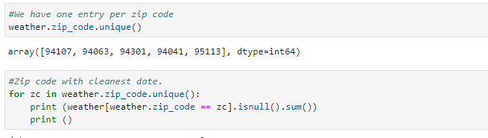
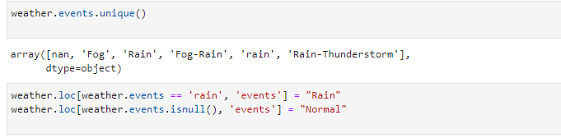
Missing Value Analysis
After analyzing all the datasets we found that multiple values for ZipCode and events were null .
ZipCode - We have modelled the data according to the unique zip codes of the bay area .Thus eliminating the null values.
2. Events - The filtered data still had 574 null records in the Events column . To overcome this issue, we have found out the unique values of events and modelled the data according to it.

Slide 11
3. Max_gust_speed_mph - Upon further filtering of the data , there were still 12 null records for Max_gust_speed_mph column. We have find the median of max_gust_speed for each value of max_wind and filled the null values .

Slide 12

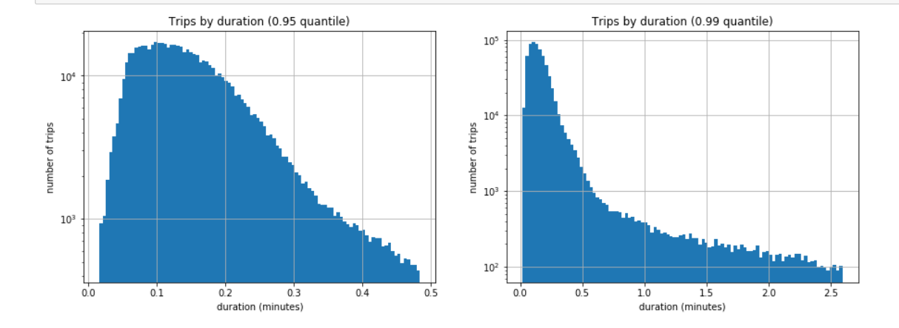
Getting rid of the outliers i.e less than 0.5% of the data
Outlier Analysis

Slide 13

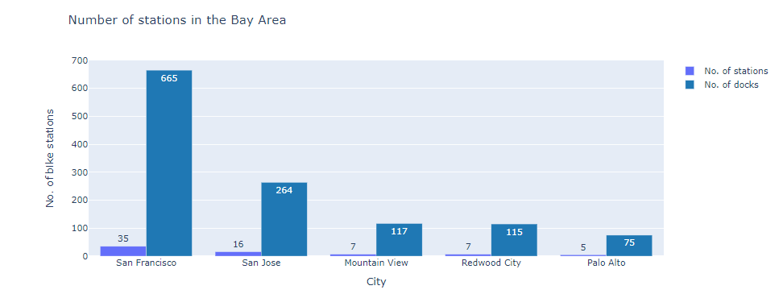



Exploratory Analysis
A plot of number of stations in the Bay Area

Slide 14
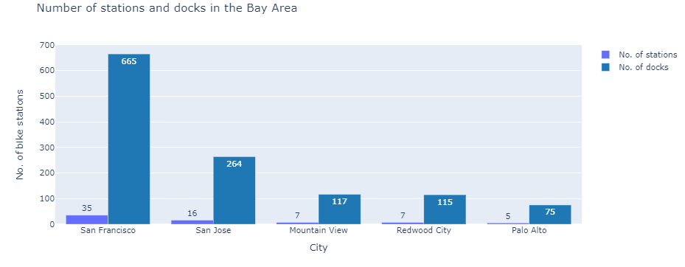
Exploratory Analysis
Plotting the number of stations and docks in the Bay Area

Slide 15
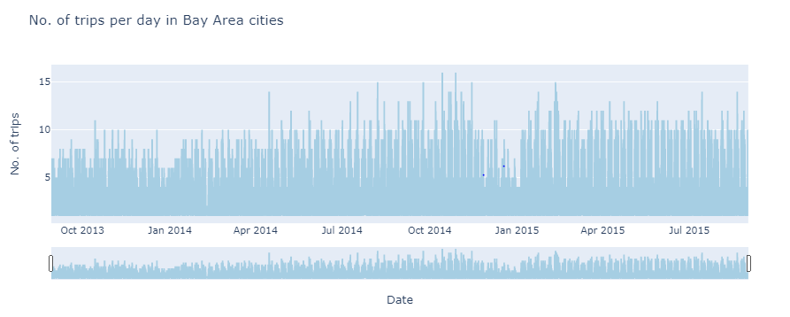
Exploratory Analysis
Number of trips per day in Bay Area

Slide 16
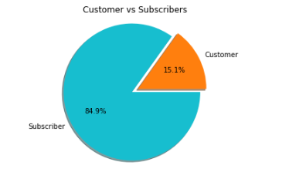
Exploratory Analysis
Customer vs Subscriber Data

Slide 17
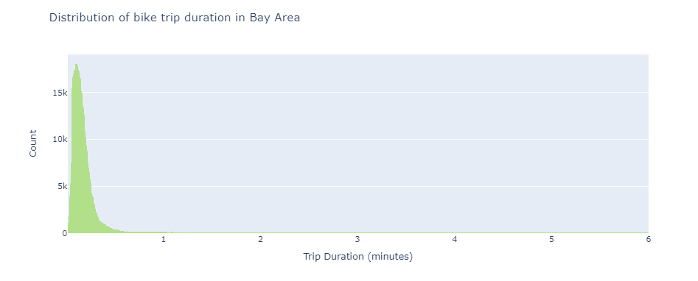
Exploratory Analysis
Distribution of bike trip duration in Bay Area

Slide 18
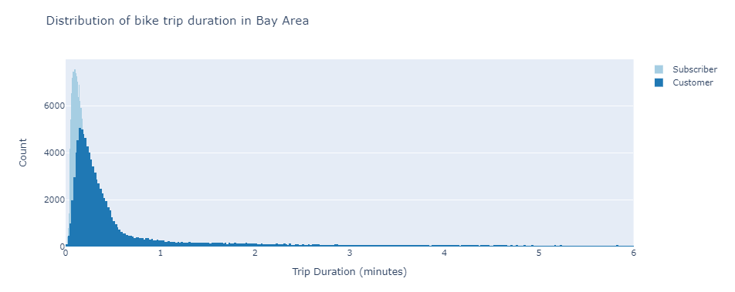
Exploratory Analysis
Distribution of bike trip duration in Bay Area By Subscription

Slide 19
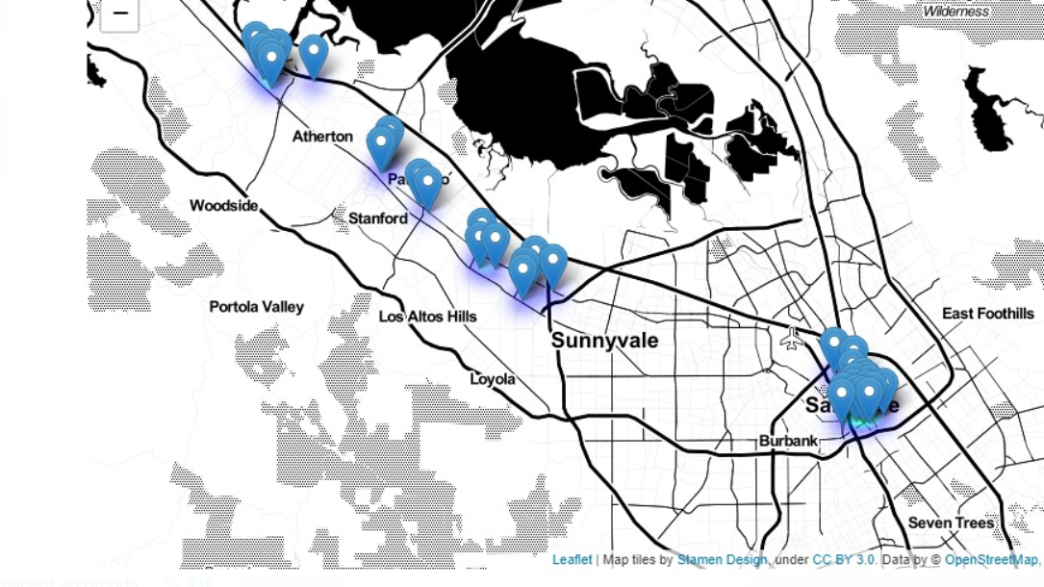
Exploratory Analysis
A heat map of number of stations in the sf bay area

Slide 20
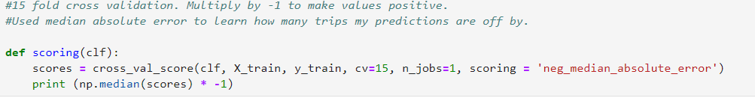
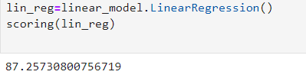
Model Analysis
Linear Regression
A machine learning algorithm based on supervised learning.
The model is basically used for finding out relationship variables and forecasting.
Here, we are trying to predict the score of count variable i.e. the number of total rentals which will behave as a dependent variable for our analysis.
The accuracy of the dataset using Linear Regression algorithm is 87.25

Slide 21
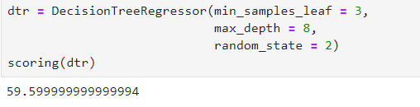
Model Analysis
Decision Tree Regressor
A machine learning algorithm based on supervised learning.
The goal of using a Decision Tree is to create a training model that can use to predict the class or value of the target variable by learning simple decision rules inferred from prior data(training data).
The accuracy of the dataset using Decision Tree Regressor is 59.59

Slide 22
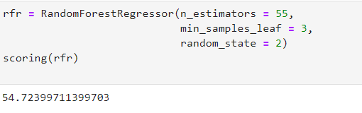
Model Analysis
Random Forest Regressor
A machine learning algorithm based on supervised learning.
A Random Forest is an ensemble technique capable of performing both regression and classification tasks with the use of multiple decision trees and a technique called Bootstrap Aggregation, commonly known as bagging
The accuracy of the dataset using Random Forest Regressor algorithm is 54.72

Slide 23
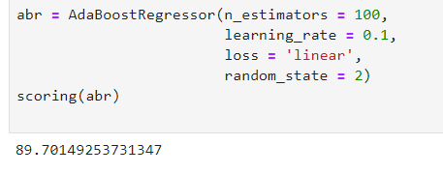
Model Analysis
Ada Boost Classifier
AdaBoost Model is used to boost the performance of decision tress on binary classification problems.
This model is commonly used in decision trees with one level.
In bike rental prediction Ada boost will be useful with stationary data.
The accuracy of the dataset using Ada Boost Classifier is 89.70

Slide 24
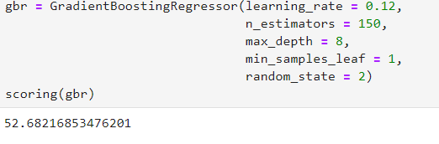
Model Analysis
Gradient Boosting Regressor
Gradient boosting is a machine learning technique for regression and classification problems, which produces a prediction model in the form of an ensemble of weak prediction models, typically decision trees.
Boosting is a method of converting weak learners into strong learners. In boosting, each new tree is a fit on a modified version of the original data set.
The accuracy of the dataset using Gradient Boosting Regressor is 52.68

Slide 25
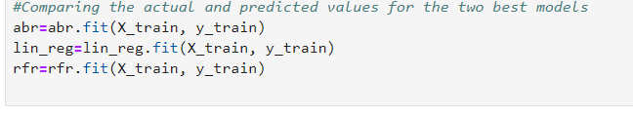
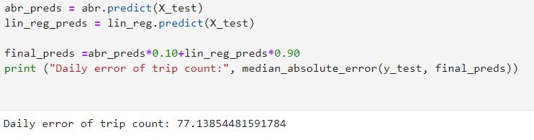
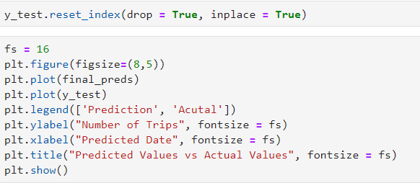
Comparing the best two models
We found that actual and predicted values are very close to each other which proves that these two models are most efficient ones when predicting the dataset

Slide 26
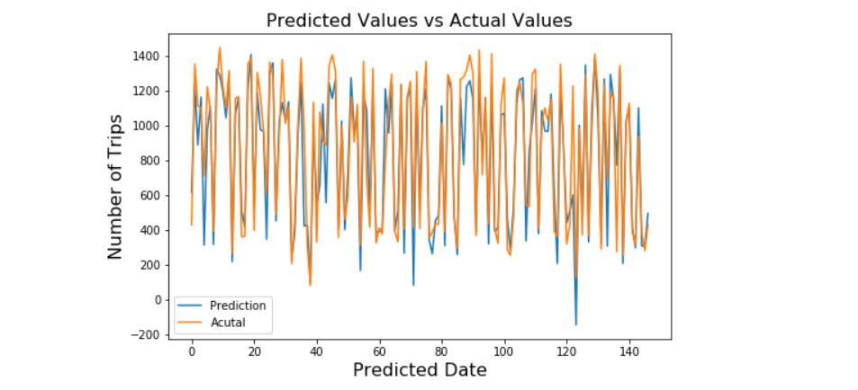
Predicted Values Vs Actual Values
This plot shows us that the predicted and actual values are almost similar to each other which tends to justify the high efficiency of the two best models that is Ada Boost Classifier and Linear Regression

Slide 27
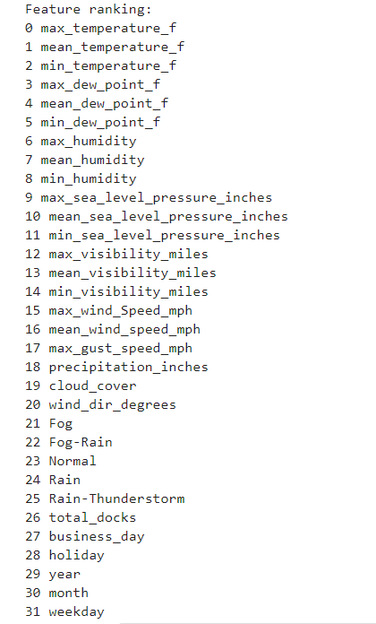
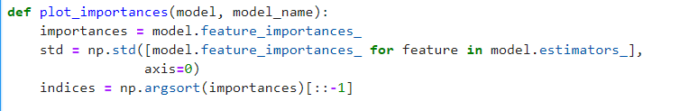
Feature Engineering And Correlation Analysis
Create a plot that ranks the features by importance.
Print the feature ranking

Slide 28
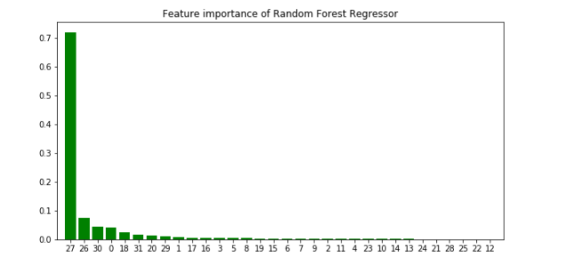
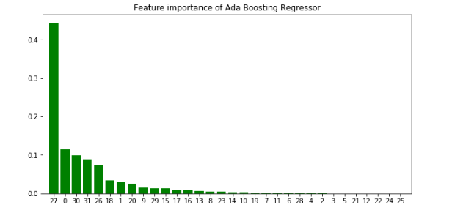
This trends shows that the columns business_day(27), max_temperature_f(0) and min_temperature_f(2) column plays a major role while renting a bike

Slide 29
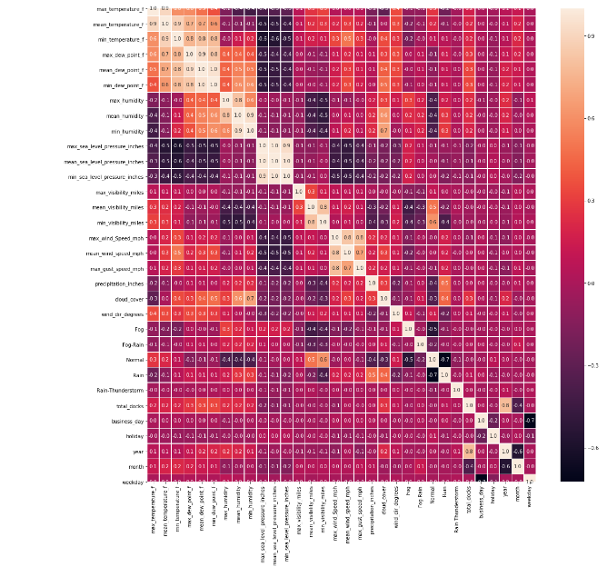
This plot shows a
trend of
correlation
between all the
features of the
dataset

Slide 30
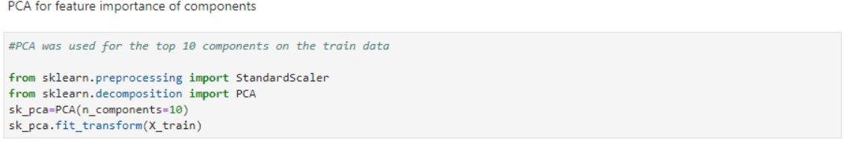
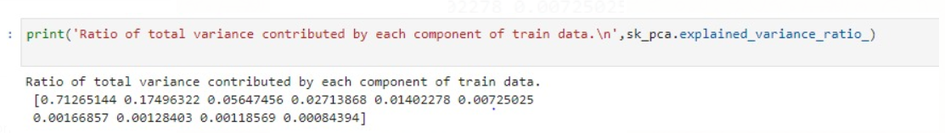
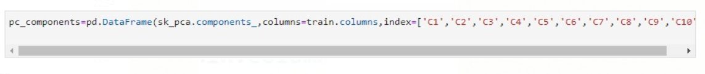
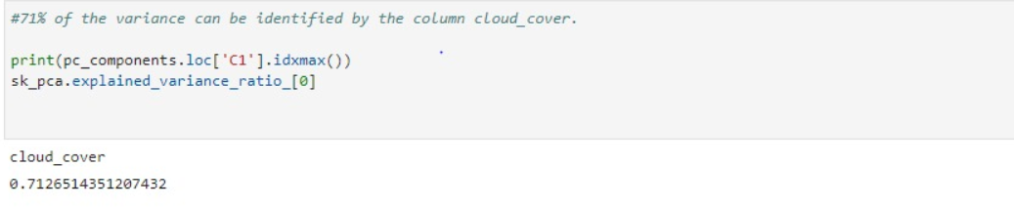
Principle Component Analysis
PCA was performed to identify top 10 components explaining the variance in the data.
71% of the variance can be explained by only one component that is cloud_cover.

Slide 31

RESULT AND ANALYSIS
Accuracy of Models:
Linear regression - 87.25
Decision Tree Regressor – 59.59
Random Forest Regressor – 54.72
Ada Boost Classifier – 89.70
Gradient Boosting Regressor – 52.68

Slide 32

CONCLUSION
Bike Search and Rental data is a great source of information for studying the mobility of a city. Additionally, this data set is bound to grow exponentially over the coming years.
In this project we have tried to predict the bike rentals by using different algorithms and have got the result to a 89.70% accuracy.
With discovered various factors that play an important role when predicting sales from the given dataset to increase our revenues such as weather conditions, number of bikes available, trends of customer etc.
Analyzing the status data to co relate all the features to get a better idea of column’s compatibility with each other.
Hence, there exists great interest in these systems due to their important role in traffic, environmental and health issues and we can easily predict the most of important events in the city could be detected via monitoring these data.

Slide 33

References
https://www.kaggle.com/currie32/a-model-to-predict-number-of-daily-trips
[1] S. A. S. et al., “Public bikesharing in north America during a period of rapid expansion: Understanding business models, industry trends and user impacts”, in Mineta Transportation Institute (MTI), 2015, p. pp. 5.
[2] “What is Exploratory Data Analysis?”, May 23, 2018. Accessed on: April 03, 2020. [Online]. Available: https://towardsdatascience.com/exploratory-data-analysis-8fc1cb20fd15
[3] “Linear Regression”. Accessed on: April 09, 2020. [Online]. Available: http://www.stat.yale.edu/Courses/1997-98/101/linreg.htm
[4] “Decision Tree Regression”. Accessed on: April 12, 2020. [Online]. Available: http://www.stat.yale.edu/Courses/1997-98/101/linreg.htm
[5] Andy Liaw and Matthew Wiener. Classification and regression by random forest. R News, 2(3):18-22, 2002.
[6] “A Model to Predict Number of Daily Trips”, Kaggle, Feb. 16, 2017. Accessed on: March 10, 2020. [Online]. Available: https://www.kaggle.com/currie32/a-model-to-predict-number-of-daily-trips

Slide 34
THANK YOU!!

